Slide 1


Slide 2

Diversity Training
Instructor:
Date:

Slide 3
OBJECTIVES
Objectives: (Classroom)
To provide a clear understanding of what diversity is and what it isn't.
To raise a greater awareness and sensitivity to Diversity issues that go well beyond the assumed categories.
To recommend behavioral tools for fostering a more cohesive workplace

Slide 4
OBJECTIVES
Method Of Instruction:
Lecture development
Training Aides:
Lecture/Test
Pen and paper are required

Slide 5

Diversity Defined
Diversity is the mosaic of people who bring a variety of backgrounds, styles, perspectives, values and beliefs as assets to the groups and organizations with which they interact.

Slide 6
Diversity
Distinction Between EEO, Affirmative Action and Diversity & Inclusion
Equal Employment Opportunity
The enforcement of statutes to prevent employment discrimination
Affirmative Action
The effort to achieve parity in the workforce through outreach and eliminating barriers in hiring
Diversity & Inclusion
Leveraging differences in the workforce to achieve better results

Slide 7
Diversity
Primary and Secondary Dimensions of Diversity
Geographic Organizational Role and Level
Location Communication Style
Military Experience Family Status
Work Experience Work/thinking Style
Socioeconomic status Education
Religion Age
First Language Gender
Sexual Orientation Disability
Ethnic Heritage Race

Slide 8
Diversity
All Communication is Filtered Through Your Cultural Perspective
Age Geographic location
National origin Functional discipline
Race Languages used
Sexual orientation Values
Religion Communication style
Disability Work Style
Gender Learning style
Education Economic status
Work role/experience Family situation
Personality Military experience
Customs Philosophical perspective

Slide 9

Diversity
A New Metaphor for Canadian Culture
The “melting pot” theory of Canadian society has evolved, instead consider a vegetable soup metaphor.
You can easily identify and taste the unique flavors of the individual parts.
Members of various cultural groups may not want to be assimilated, they want their tastes, looks and texture to remain whole.
To reap the business benefits of diversity, you must employ inclusive work strategies

Slide 10
Diversity
VA’s Diversity & Inclusion Goals: Making Full Use of the Unique Skill Sets of Each Employee
Food for Thought:
Do I bring my “full self” to work?
My ideas | My personality
My opinions | My uniqueness
My background

Slide 11
Diversity
Benefits of Workforce Diversity & Inclusion
Improved understanding of those you work for, with, and around.
Creates a work environment that allows everyone to reach their full potential.
Provides multiple perspectives on problem solving.
Better performance outcomes.
Increases employee productivity.
Increased retention rates.
Boosts employee morale.
Improved customer relations.
Reduces complaints and grievances.
It’s the right thing to do!

Slide 12
Diversity
The Business Imperative: What does the research show?
Workforce diversity is positively associated with higher business performance outcome measures.
Racial diversity is positively associated with higher performance in organizations that integrate and leverage diverse perspectives as resources for product delivery.
Gender diversity is positively associated with more effective group processes and performance in organizations with people-oriented performance cultures.
Diverse teams are more creative and perform better in problem solving than homogeneous teams.*
The effects of diversity on group processes and performance are highly dependent on the presence of facilitating or inhibiting conditions in the organization; absent facilitating conditions, the aforementioned outcomes are reversed.

Slide 13
Legal Issues – Use of Force
The Human Imperative: What are the lessons learned?
Case in Point: Intelligence Community
Obstacles leading to intelligence failures included:
Hardened attitudes against change
Insular organizations
Resistance to external recommendations
Insistence on preserving the status quo
Recommendations for improvements in performance culture include:
Agencies should encourage dissent, not smother it.
Move away from tradition of searching for consensus in favor of open debate and more diverse spectrum of views.

Slide 14
Diversity
The expression of an organization’s collective values, beliefs, and behaviors.
Key Questions
Do staff, volunteers, or program participants "check their individual identities at the door?”
What’s wrong with just being “color-blind” or “gender-blind” or whatever-kind of blind?
Does the “way we’ve always done it” close out thinking as well as staff, volunteers, program participants and community partners?
Is there some way you “ought to be” in order to fit in the association and its programs?

Slide 15
Diversity
Organizational Inclusion
Extent to which the organization provides fair and equitable treatment to all employees and groups
Equity of Practices
Extent to which culture avoids assimilationist strategies and is open to learning from different and non-traditional sources
Organizational Culture
Extent to which the organization draws upon diverse sources of knowledge and experience for planning and operations
Voice & Participation

Slide 16
Diversity
Cultural Competence
Cultural Competence is the ability to respond effectively and appropriately to different cultural/generational contexts in the workplace.
Acknowledge and accept differences in cognitive, behavioral, philosophical, social, and communicative styles that arise from different cultural generational contexts.
Seek to understand; ask for clarification or reasons for the behavior
Communicate policies, procedures clearly to employees if you are a manager

Slide 17
Diversity
Cultural/Generational Differences
Individual vs. team work orientation
Visual vs. oral learning style
Expressive vs. introverted behavior
Physical vs. non-physical
Emotive vs. reserved personality
Assertive vs. acquiescent behavior
Gregarious vs. solitary social style
Work vs. family focus
Divergent vs. convergent thinking
Long term vs. short term career planning

Slide 18
Diversity
Cultural Competence
Respect others’ opinions.
Acknowledge cultural/ generational differences and historical injustices without becoming defensive.
Be open to learning about other cultures and ideas.
Give others the benefit of the doubt in a dispute.
Seek first to understand others’ point of views; then to be understood.
Don’t stereotype.
Don’t judge others by your own cultural standards.
Don’t assume your culture’s way is the only way.
Don’t talk down to anyone; communicate effectively.

Slide 19
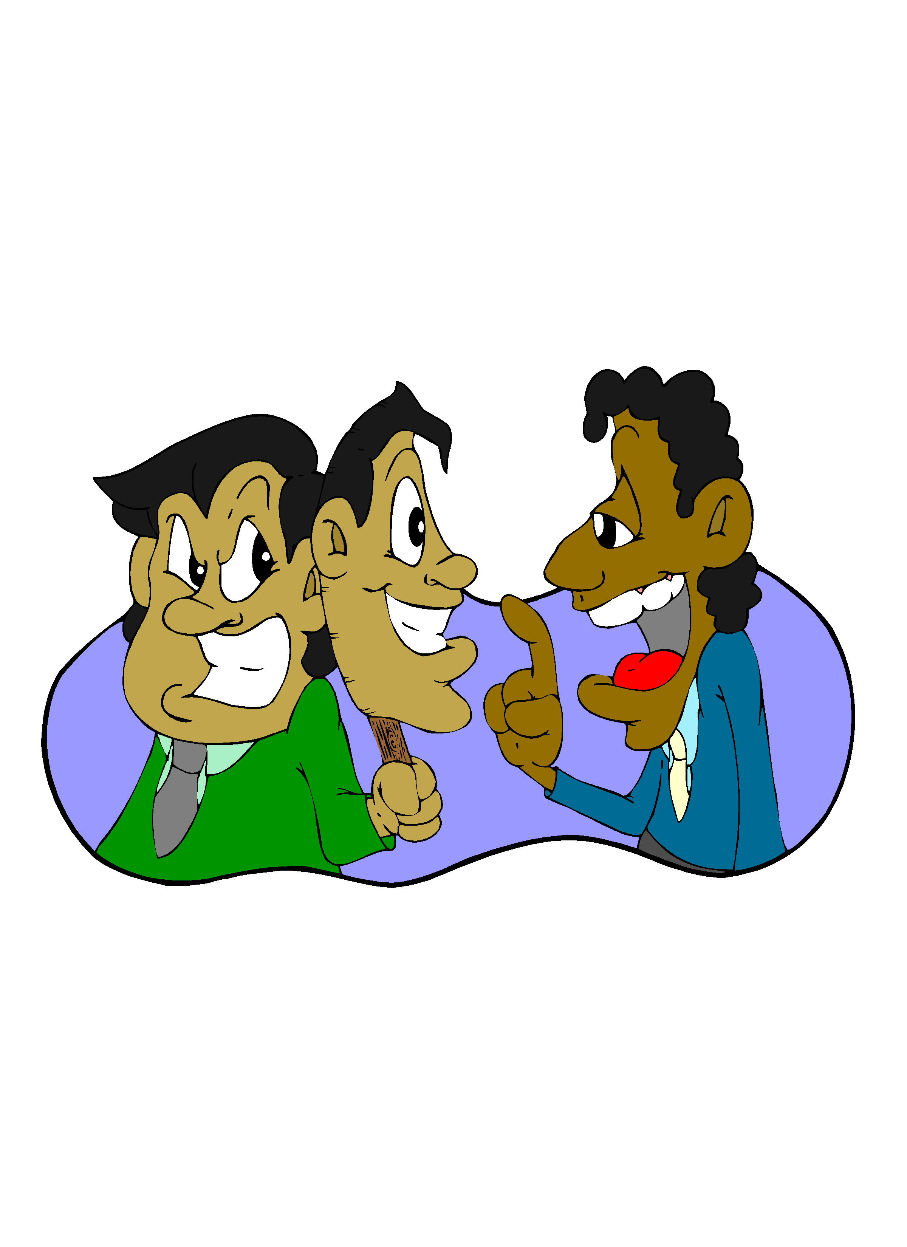
Legal Issues – Self Defense
Impediments to Cross-Cultural Communication
Irrational Assumptions
Misunderstanding
Prejudice
Fear

Slide 20
Diversity
Irrational Assumptions
An irrational assumption is a belief that is founded on baseless supposition, often skewed by bias. One of the best examples of irrational assumptions are the stereotypes we formulate about people based on their association or membership with cultural or ethnic groups.
“If we all worked on the assumption that what is accepted as true is really true, there would be little hope of advance.”
--Orville Wright

Slide 21
Diversity
Misunderstanding
Misunderstandings are a normal part of communication either because we unintentionally or intentionally use the wrong words or because we don’t understand what is being said to us. To prevent misunderstanding know who you’re talking to, be respectful, and be sure of what you want to say.
“Listen, I’m going to talk to the Indians. It’s probably a misunderstanding.”
--General Custer

Slide 22

Diversity
Number 1 Rule for Diversity, Inclusion, and Constructive Conflict Management
Dialogue! In order to understand the other’s point of view, seek first to understand.
Dialogue! In order to communicate your own position.
Dialogue! In order to arrive at a mutually beneficial agreement that serves common goals.

Slide 23
Diversity
How Can Managers Promote Diversity & Inclusion?
Lead employees by example; respect people and differences in the workplace.
Create a welcoming, inclusive environment in which to conduct business.
Incorporate diversity in policies, strategic plans, operational procedures.
Learn and practice early conflict resolution strategies.
Practice regular, effective, and open communication; empower your employees; requires trust.
Demonstrate executive commitment to diversity on an ongoing and regular basis.
Walk the talk.

Slide 24
Diversity
Diversity Best Practices
Leadership commitment.
Effective communication and transparency.
Equitable employment practices.
Recruitment outreach.
Continuous learning and career development.
Coaching and mentoring.
Early conflict resolution.
Flexible work culture.

Slide 25
Diversity
Leadership Commitment
Communicate and practice commitment to diversity and inclusion often.
Reinforce diverse work and employment practices, including diversity of thought.
Practice constructive conflict management.
Educate the workforce on the business value of diversity and inclusion.
Mentor and coach diverse employees.

Slide 26
Diversity
Career Development
Definition: aligning the needs of the organization with the professional development of its employees.
Diversity & Inclusion should be incorporated in career development, especially in the following areas:
Succession planning
Internal mobility systems
Training and development opportunities
Performance management--ensure evaluations don’t include subtle biases against diverse groups of people

Slide 27
Diversity
Recruitment Outreach
Cast the net wide: Recruitment outreach efforts should target a wide variety of academic, professional and community organizations for the most talented and qualified persons in diverse groups.

Slide 28
Diversity
How Can Employees Promote Diversity?
Practice positive, constructive work habits in the workplace; work cooperatively towards a common goal.
Live up to the social contract; contribute to your fullest potential; strive for excellence.
Recognize and respect others and their individuality.
Think before you speak and be sensitive to others.
Talk about your differences and ask tactful questions about how people want to be treated.
Eliminate stereotypes and generalizations.

Slide 29
Diversity
Diversity is only FAIR
Feedback/communication promotes understanding, reduces conflict; and enhances productivity.
Assist others to become culturally competent; support one another – we are all in this together!
Inclusion should be practiced; empower employees to fully perform and participate in pursuit of the organization’s mission.
Respect is non-negotiable; honor the social contract.

Slide 30

Diversity
Last Words To Ponder
“When we feel a sense of belonging it is not because we are the same as everyone else, but because we have been accepted as we are.”

Slide 31
Things you should know
If a Sobeys staff member asks you to stop a shoplifter what do you do?
Answer: Politely explain to the staff member that you did not see the offence therefore the law does not permit you to act. However if they witnessed the offence and have full Selection, Concealment, Continuity and Exit, you can accompany them as they make the arrest

Slide 32
Things you should know
When can you stop a suspected shoplifter?
Answer: When you see a person select an item, Conceal that item, maintain full visual continuity of that person(ensuring they did not dump the item) and the person exited the store

Slide 33
Things you should know
Have you received training for diversity, discrimination/Profiling?
Answer: Yes. With completion of this test and PowerPoint handout.

Slide 34
Things you should know
Explain what discrimination/profiling means to you?
Answer: You cannot treat any person different due to their Race, color, Religion, Creed, Family Status, ethnic origin, mental ability, gender or age.

Slide 35
Things you should know
What is the purpose of the sensormatic system at the doors?
Answer: To deter shoplifters and to see if any security tags were not deactivated at the registers

Slide 36
Things you should know
What should you do when the Sensormatic system goes off?
Answer: Approach the customer in a calm manner and try to determine what product activated the sensormatic. Ensure you log the event.

